Slide 1

Computational Chemistry: An Organic Chemist’s Perspective
Assistant Professor Dr. Dennis Svatunek University of Malaya, 12th of November 2025

Slide 2
Conformer Searches

Slide 3
1. Conformer Searches
Conformers are different spatial arrangements of a molecule→ obtained by rotation around single (σ) bonds
They have the same connectivity, only different geometry
Often close in energy → can interconvert at room temperature

Slide 4
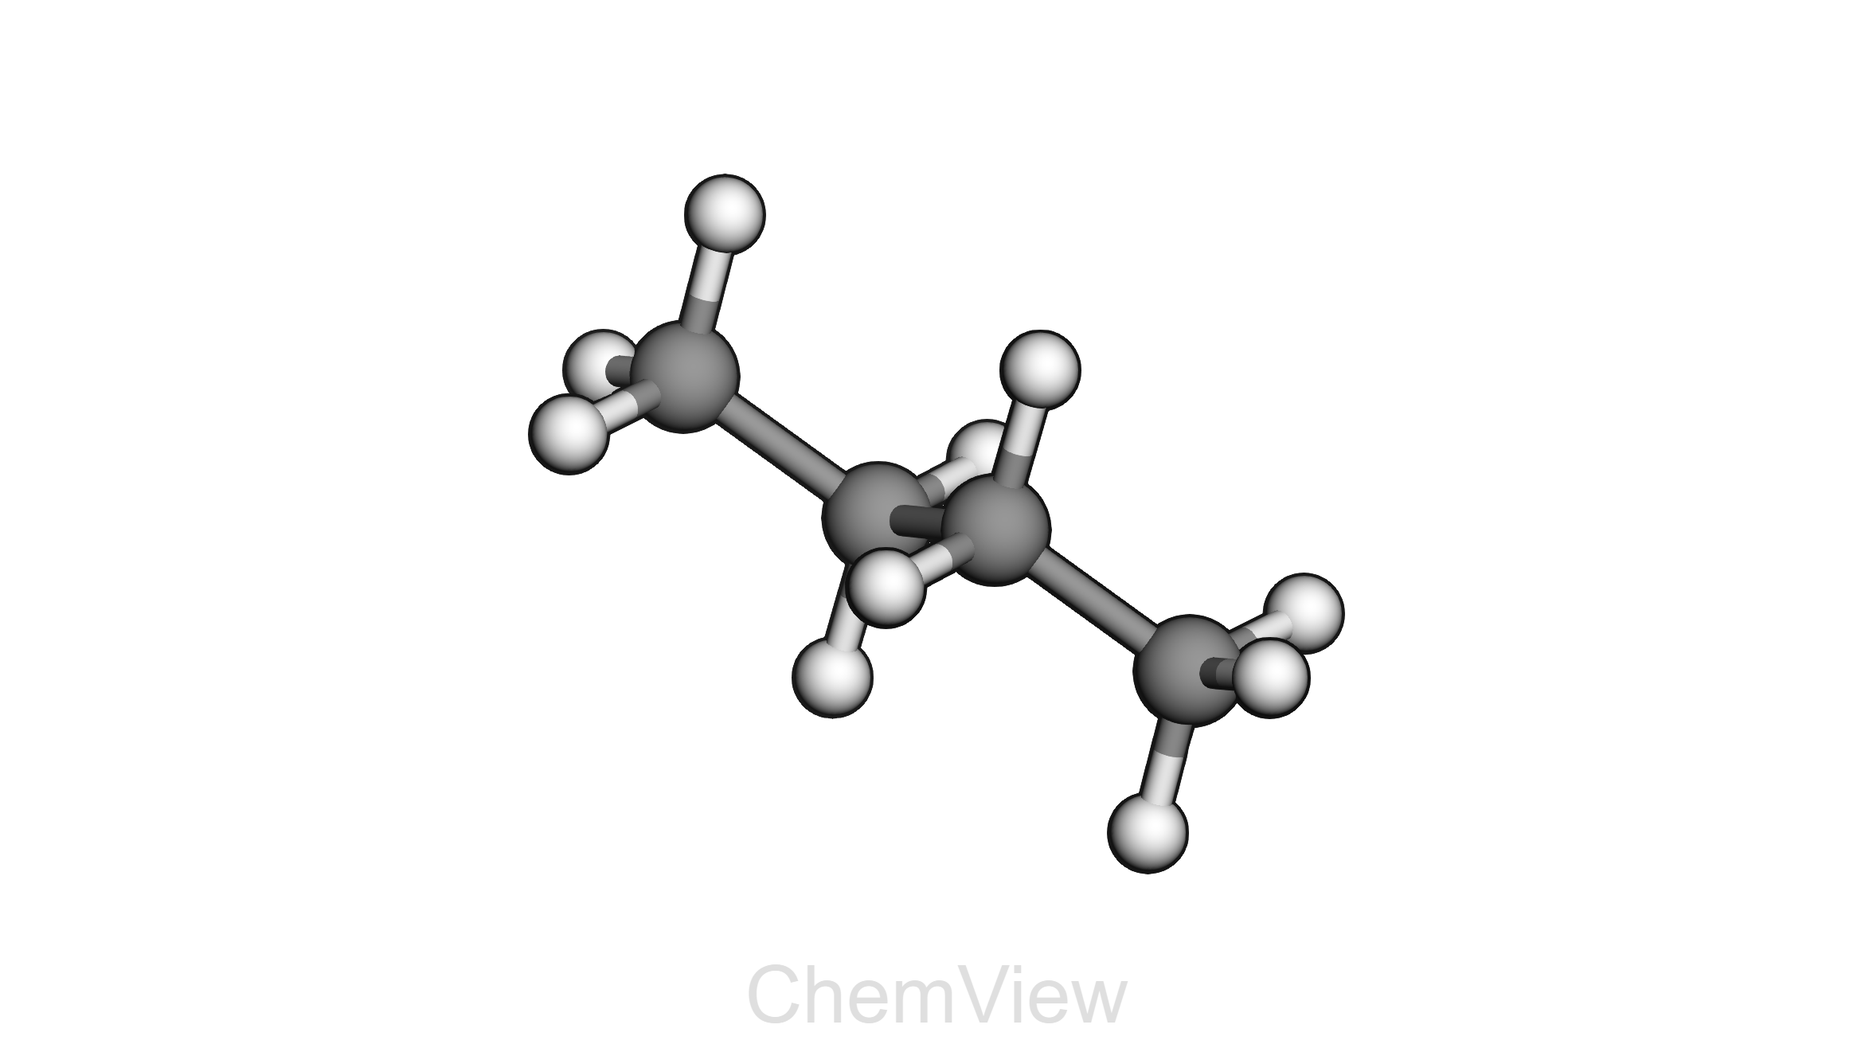
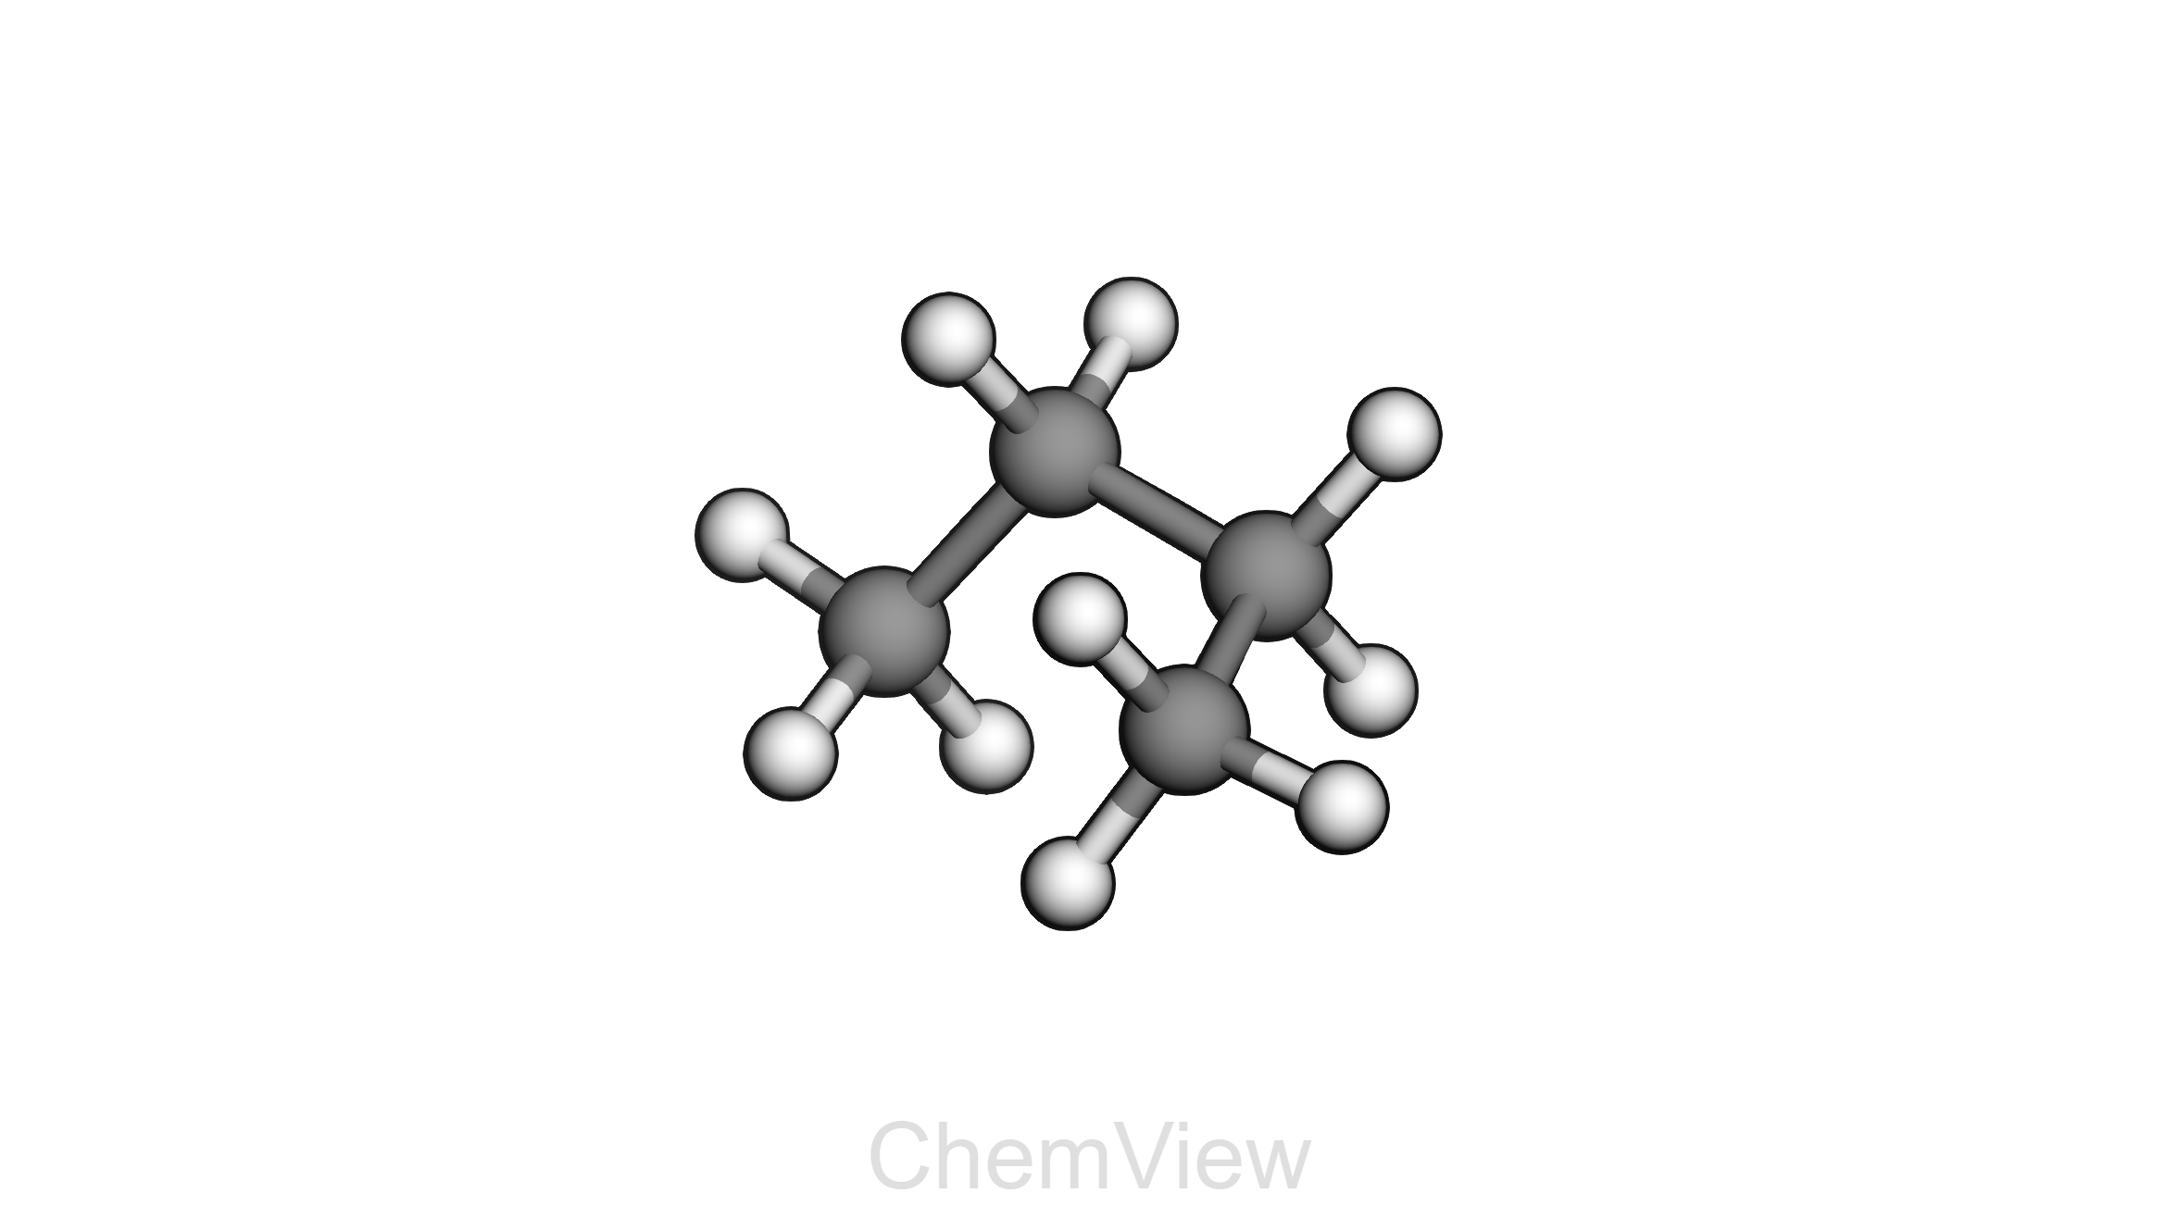
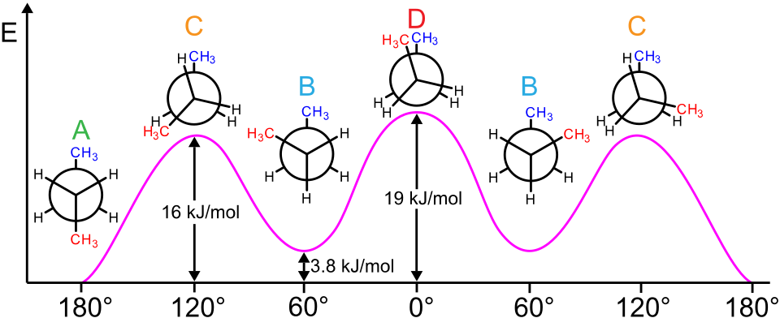

Slide 5
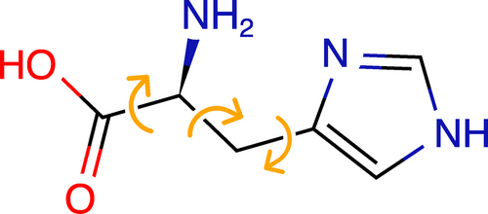
Notes:
histidine

Slide 6
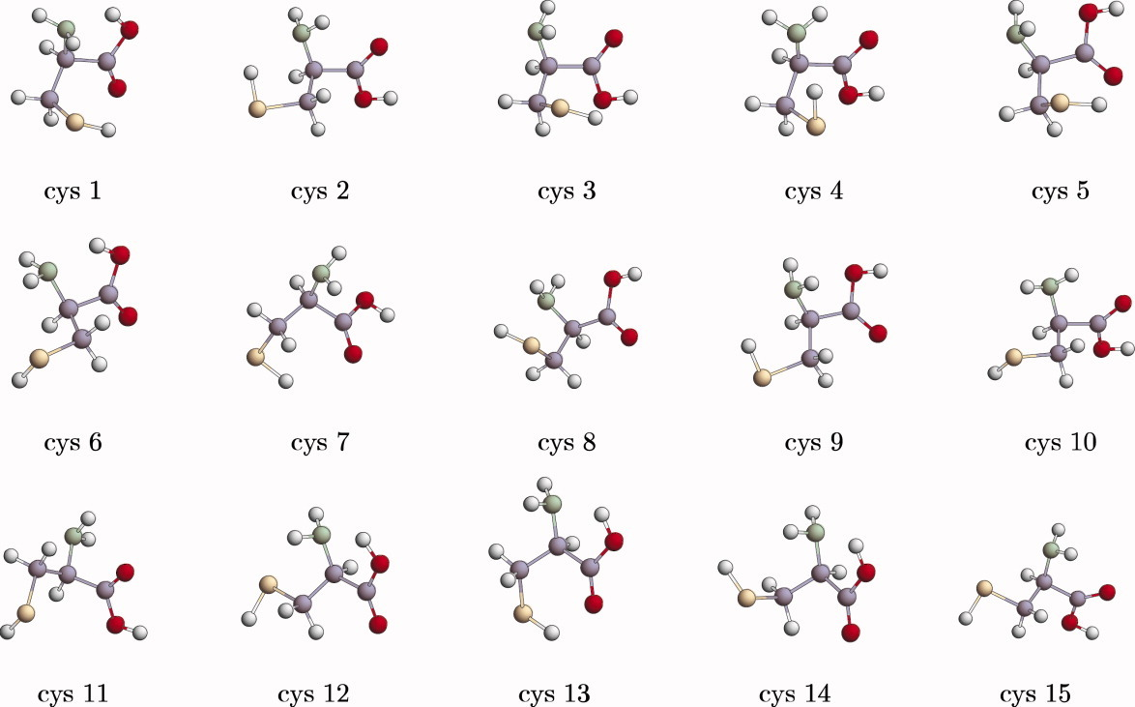
Notes:
cysteine

Slide 7
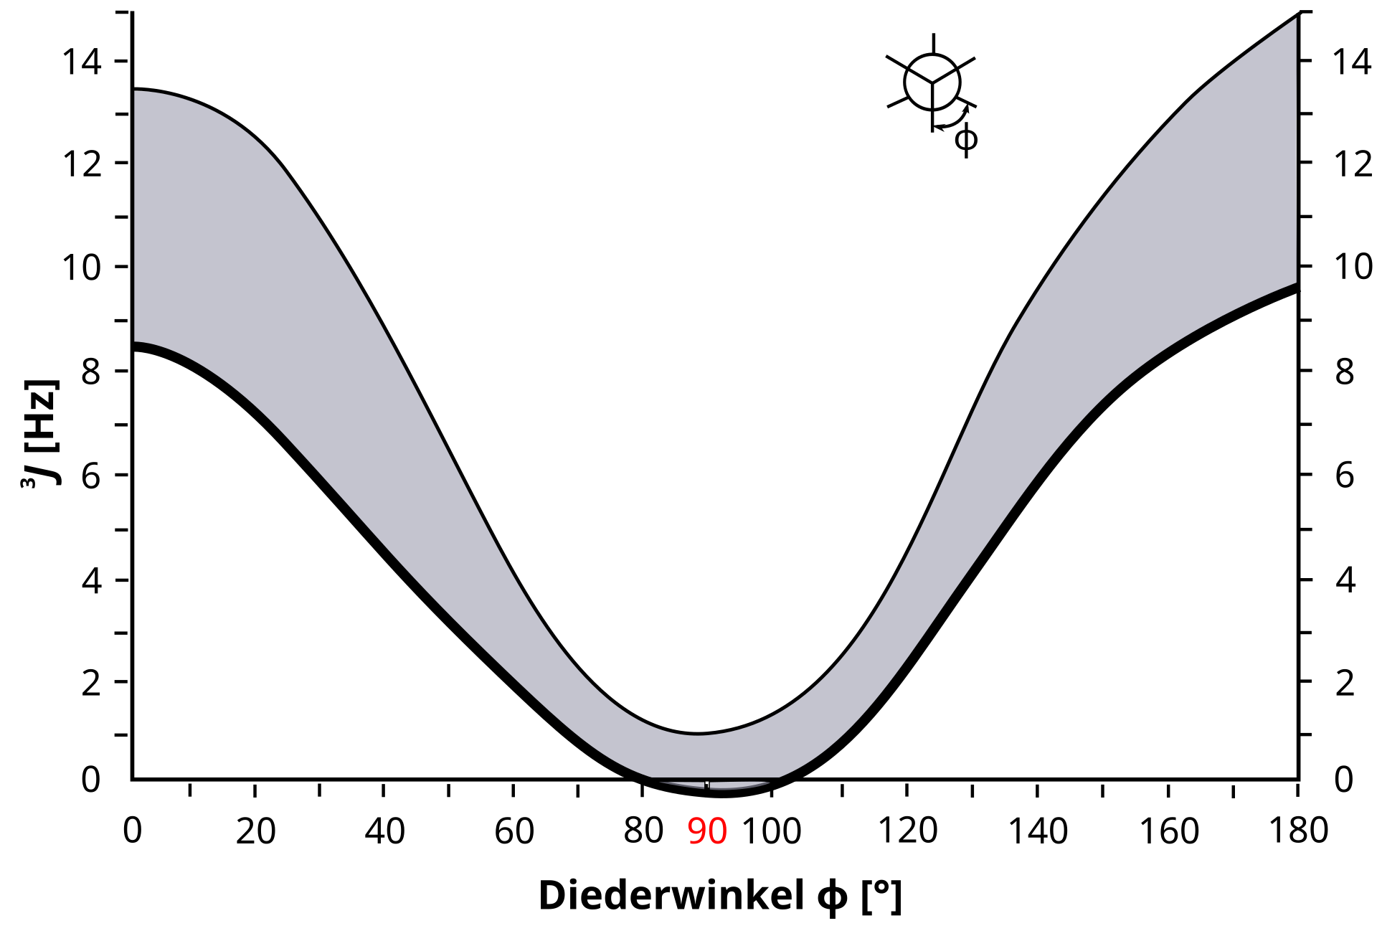
Why care about conformers?
Conformers often have different energies → one (or more) may dominate at equilibrium
Different conformers can show different physical or spectroscopic properties, e.g.
Dipole moment → affects polarity, solubility, IR intensity
NMR coupling constants → depend on dihedral angles (Karplus relation)
UV/Vis or IR spectra → sensitive to geometry and H-bonding

Slide 8
Conformer Search
Instead of optimizing one arbitrary conformer drawn by the researcher (introduces bias)
Goal: identify the lowest-energy conformer or an ensemble of low-energy conformers
Use the lowest-energy structure or a Boltzmann-weighted ensemble for further calculations and property predictions

Slide 9
Conformer Search
Step 1:
Generate potential conformers
Step 2:
Filter generated structures for unique conformers
Energy threshold
Geometric similarity threshold (RMSD)
and remove high energy conformers (e.g., ΔE > 6 kcal/mol)

Slide 10
Root-Mean-Square Deviation (RMSD)
Quantifies how similar two molecular geometries are
Calculated from the average distance between corresponding atoms after optimal alignment
Commonly used to:
Detect duplicate conformers after a search
Compare a computed structure to an experimental geometry
Assess structural changes during optimization or dynamics
Typical threshold for duplicate filtering: RMSD < 0.1–0.2 Å

Slide 11
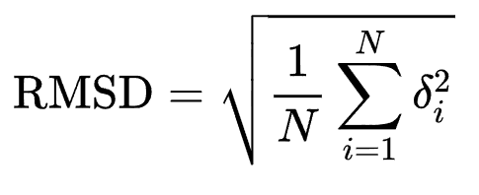
Root-Mean-Square Deviation (RMSD)

Slide 12
Systematic Search
Rotate all rotatable bonds in fixed angle increments (e.g., 60° for C–C single bonds)
Generate all possible combinations of torsions → set of trial geometries
Optimize each structure to a local minimum
Compare resulting energies to identify low-energy conformers
Works well for small and rigid molecules, but becomes combinatorially expensive for flexible systems (Combinatorial Explosion)

Slide 13
Combinatorial Explosion
1 rotatable bond → 6 combinations
3 bonds → 6³ = 216
5 bonds → 6⁵ = 7,776
10 bonds → 6¹⁰ = >60 million
→ Systematic searches become impossible for flexible molecules

Slide 14
Stochastic Conformer Searches
Instead of generating all possible combinations → sample randomly
Instead of testing all combinations, sample selected regions of conformational space
Sampling can be:
Random → completely random torsion angles
Guided → biased toward chemically reasonable or low-energy regions
Each generated structure is optimized to a local minimum
Efficiently finds representative low-energy conformers without exhaustive search
Works well for flexible or larger molecules

Slide 15
Random Sampling
Randomly assign torsion angles for all rotatable bonds
Each structure is energy-minimized to reach a nearby local minimum
Repeat many times to explore different regions of conformational space
Duplicates (similar RMSD or energy) are filtered out
Efficiency improves with number of samples and quality of optimization

Slide 16
Monte Carlo Sampling
Instead of generating all possible combinations → sample randomly
Generates random conformations, but each step is guided by probability
A new structure is accepted or rejected based on its energy difference → typically using the Metropolis criterion
Allows both downhill (lower energy) and occasional uphill moves → helps escape local minima
Repeated iterations explore conformational space efficiently
Produces a set of low-energy, statistically relevant conformers

Slide 17
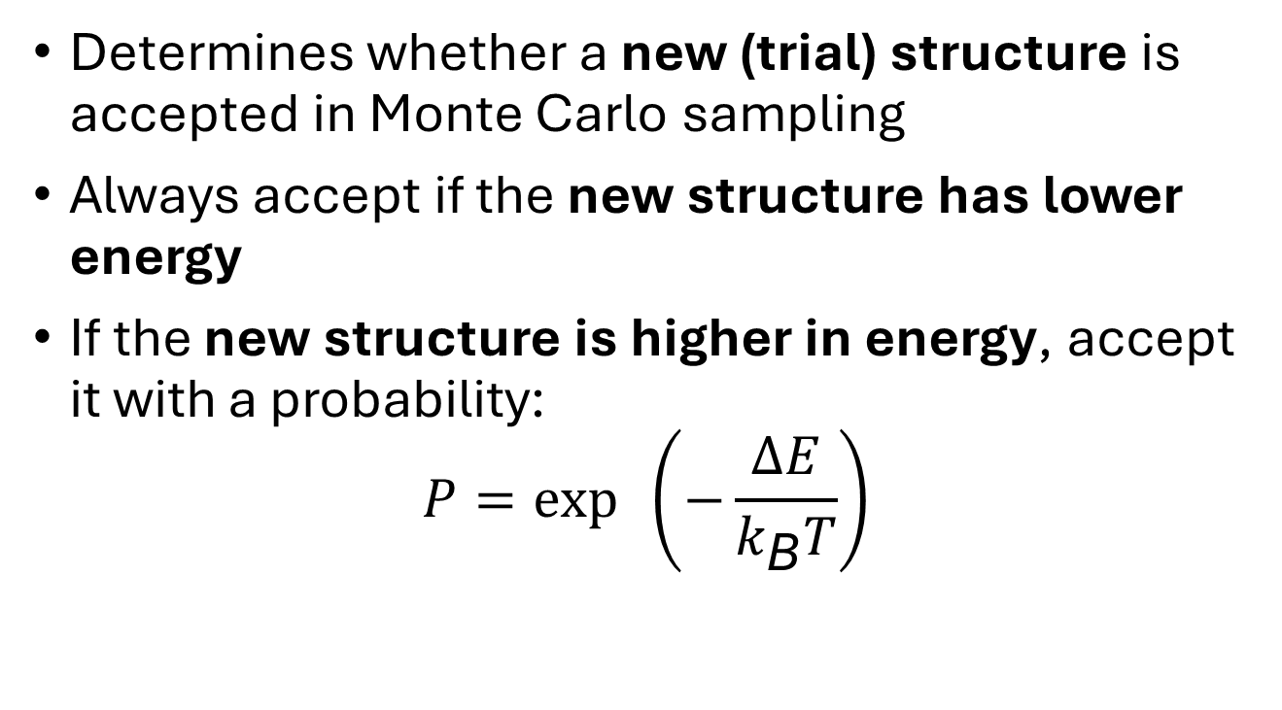
Metropolis Criterion
Determines whether a new (trial) structure is accepted in Monte Carlo sampling
Always accept if the new structure has lower energy
If the new structure is higher in energy, accept it with a probability:
$$P=\exp{ \left(−\frac{ΔE}{k_{\text{B}}T}\right)}$$

Slide 18
Molecular Dynamics
Instead of generating all possible combinations → sample randomly
Simulates atomic motion over time by integrating Newton’s equations of motion
At each time step, forces are computed from the potential energy surface
Atoms move according to 𝐹=𝑚𝑎=−∇𝐸
Generates a trajectory that samples many conformations naturally, we take snapshots
Can explore conformational changes, flexibility, and equilibrium populations
Requires a force field (e.g., AMBER, CHARMM) or a fast quantum mechanical potential

Slide 19
Problems with Classical MD
Instead of generating all possible combinations → sample randomly
MD explores conformational space through time evolution → hard to cross high energy barriers
Reaching rare conformers may require very long trajectories
Classical MD: fast but approximate (force field–dependent)
Quantum MD (AIMD): accurate but computationally prohibitive
In practice → too slow or too costly for thorough conformer searches

Slide 20
CREST (Grimme Lab)
Instead of generating all possible combinations → sample randomly
Developed by Grimme and co-workers
Combines efficient sampling with semiempirical quantum mechanics (GFN-xTB)
Uses metadynamics and genetic algorithms to overcome energy barriers
Continuously optimizes and refines conformers during the search
Produces a Boltzmann-weighted ensemble of low-energy structures
Strikes a balance between speed (sampling) and accuracy (QM forces)

Slide 21
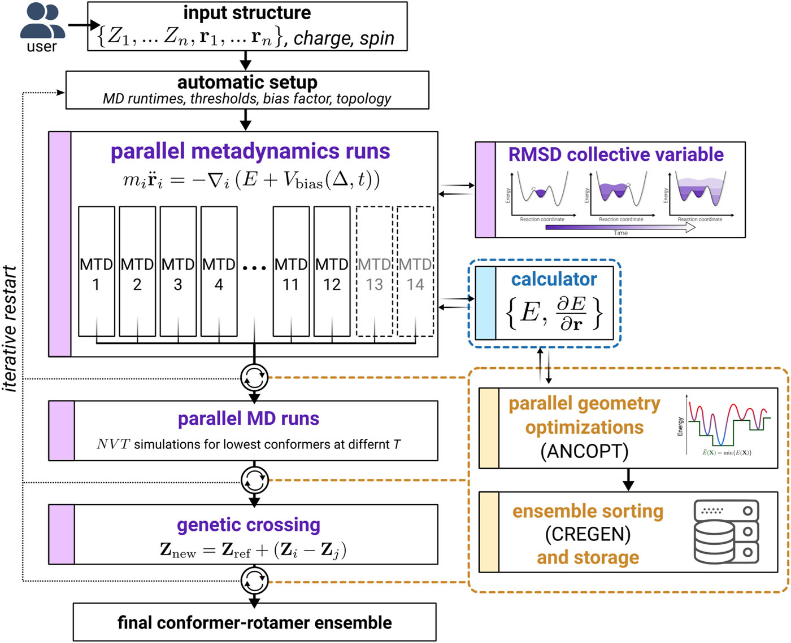
CREST (Grimme Lab)
Instead of generating all possible combinations → sample randomly

Slide 22
Meta dynamics
Sampling method that helps a system escape local minima
Adds a small biasing potential (“hill”) to the energy surface at visited points → discourages revisiting the same region
As simulation proceeds, the energy landscape is gradually flattened → allows exploration of new conformations and crossing of barriers
Commonly used with molecular dynamics or semiempirical methods (e.g., GFN-xTB in CREST)
Efficiently finds multiple minima without long MD times

Slide 23
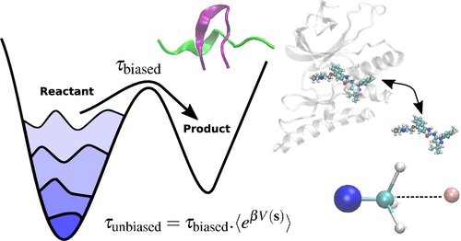
Metadynamics
Instead of generating all possible combinations → sample randomly
DOI: 10.1021/acs.jctc.3c00660

Slide 24
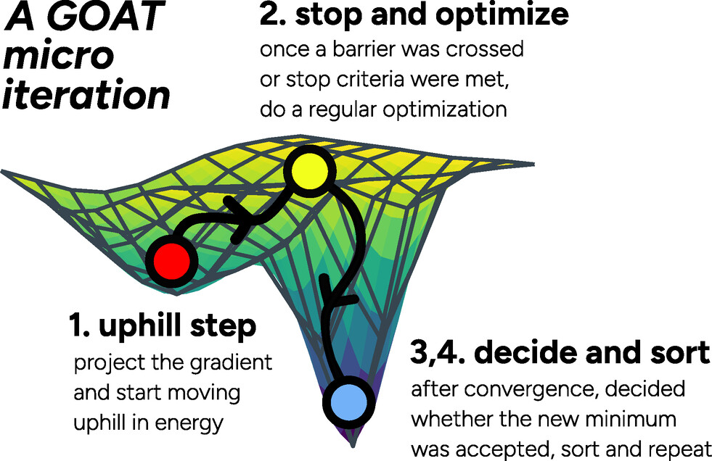
GOAT: A Global Optimization Algorithm for Molecules and Atomic Clusters
New method within ORCA → works with any FF or QM method
Systematically explores the PES

Slide 25
Energy Decomposition Analysis

Slide 26
2. Energy Decomposition Analysis
Goal: Understand molecular interactions by dividing total energies into physically meaningful contributions
This helps connect quantum-mechanical results with chemical intuition
Many different schemes exist, but they all begin with the Distortion/Interaction Analysis (DIA) as the first step

Slide 27
Distortion/Interaction Analysis
distortion energy
E
ΔE_{dist}
ΔE_{int}
ΔE
total energy
undistorted
reactants
ΔE_{int}
interaction energy
reaction coordinate

Slide 28
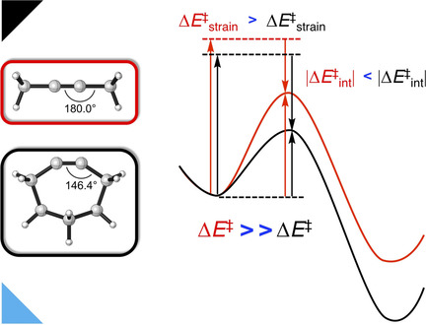
Distortion/Interaction Analysis
DOI: 10.1002/chem.201900295

Slide 29
Energy Decomposition Analysis
Further decompose E_{int} into meaningful terms
Many different Schemes available. Most popular:
ALMO-EDA
SAPT
Rauk-Ziegler (canonical) EDA
Each scheme refines E_{int} into quantitative terms that link quantum mechanics with chemical concepts like covalency, ionicity, and steric effects.

Slide 30
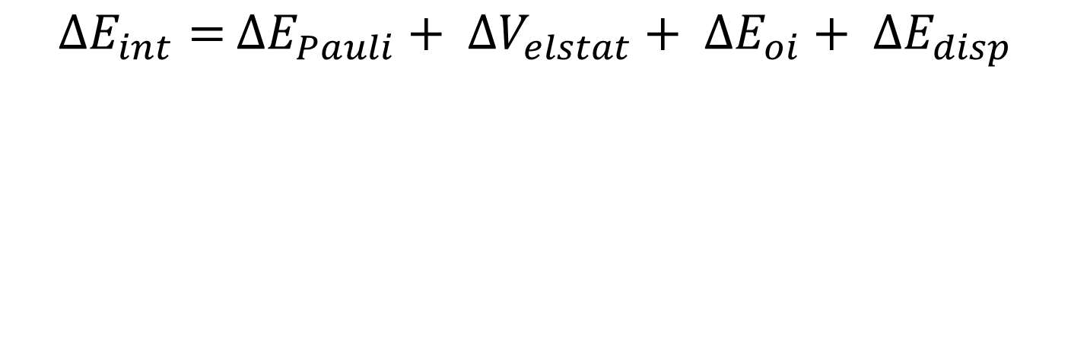
Rauk-Ziegler Energy Decomposition Analysis
Works within the DFT Kohn-Sham framework
$∆E_{int}=$ $∆E_{Pauli}+ ∆V_{elstat}+ ∆E_{oi}+ ∆E_{disp}$
∆E_{ref}+ ∆E_{pauli}+ ∆V_{elstat} + ∆E_{oi}
∆E_{ref}
∆E_{ref}+ ∆E_{pauli}+ ∆V_{elstat}

Slide 31
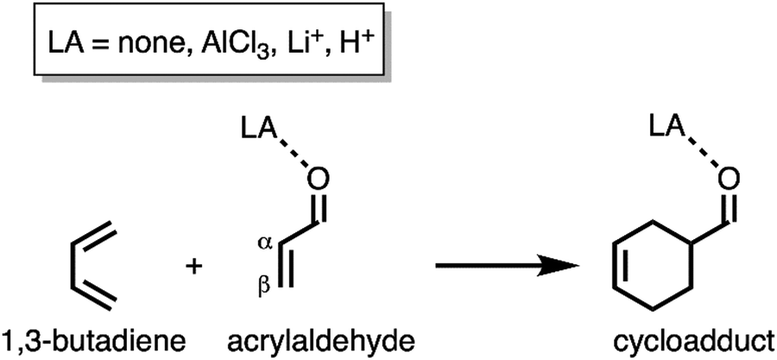
EDA in action: Catalysis in Diels-Alder reactions
 | ΔE* | ΔE_{strain} | ΔE_{int} | ΔV_{elstat} | ΔE_{Pauli} | ΔE_{oi}
O | 12.1 | 19.3 | −7.2 | −38.9 | 82.9 | −51.5
O–AlCl₃ | 1.5 | 14.9 | −13.4 | −34.5 | 73.5 | −52.4
O–Li⁺ | −1.9 | 13.5 | −15.4 | −31.3 | 68.1 | −52.2

Slide 32
Symmetry-Adapted Perturbation Theory (SAPT)
Perturbation-based decomposition built from first principles
Treats intermolecular interaction as perturbation of isolated monomers
Energy terms:
Electrostatics
Exchange (Pauli repulsion)
Induction
Dispersion
Widely used for noncovalent interactions and benchmarking

Slide 33
ALMO-EDA
Uses Absolutely Localized Molecular Orbitals to define fragments
Sequentially “turns on” electronic relaxation steps:
Frozen interaction
Polarization within fragments
Charge-transfer (delocalization)
Ensures strict separation of polarization and charge transfer
Implemented in Q-Chem, efficient for large systems
Ideal for studying hydrogen bonding, donor–acceptor, and solvation effects

Slide 34
Orbitals

Slide 35
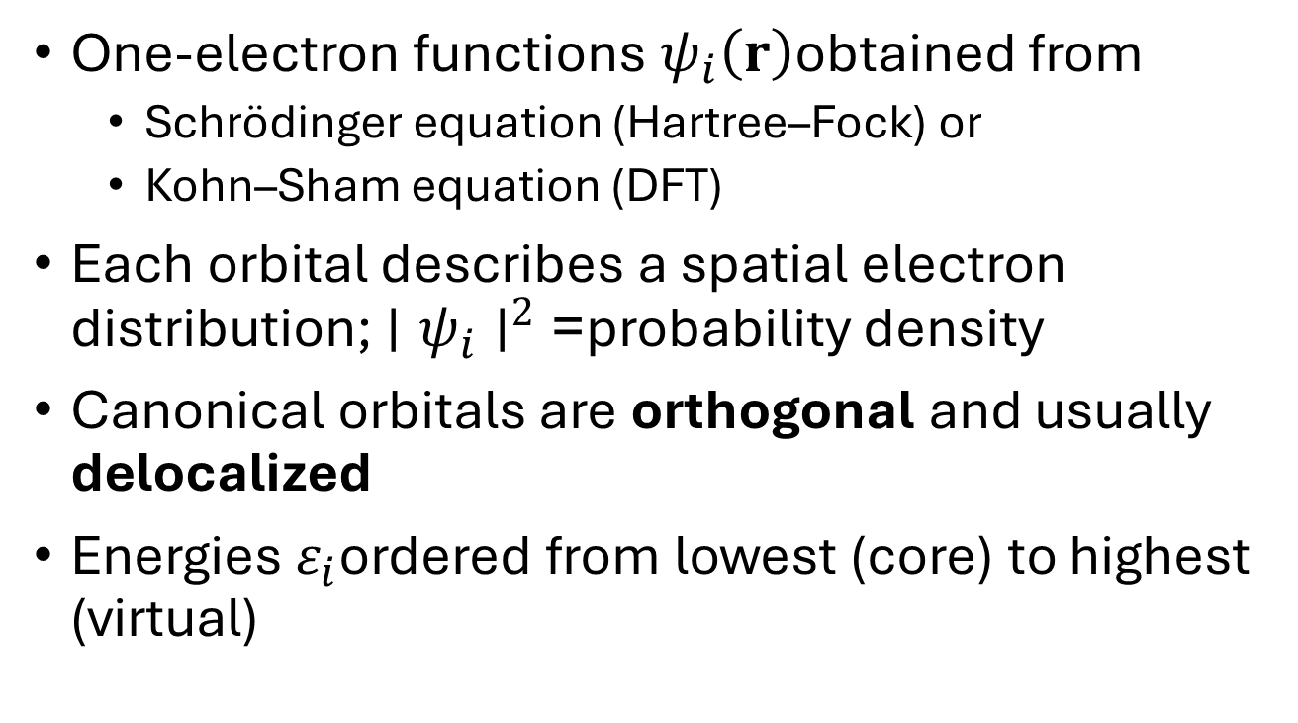
3. Orbitals
One-electron functions $ψ_{i}\left(r\right)$obtained from
Schrödinger equation (Hartree–Fock) or
Kohn–Sham equation (DFT)
Each orbital describes a spatial electron distribution; $∣ψ_{i}∣^{2}$= probability density
Canonical orbitals are orthogonal and usually delocalized
Energies $ε_{i}$ordered from lowest (core) to highest (virtual)

Slide 36
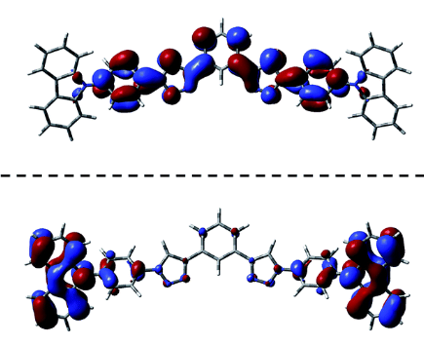
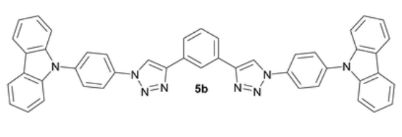
What are Orbitals used for?
Approximate excitation energies → ΔE ≈ ε_{LUMO} − ε_{HOMO}
Useful for interpreting photochemistry, donor–acceptor systems, π – π* transitions
Predicting reactivity → Frontier Molecular Orbital (FMO) theory
LUMO
HOMO
Notes:
TADF (thermally activated delayed fluorescence)

Slide 37
FMO Theory
Developed by Kenichi Fukui (Nobel Prize 1981, with Roald Hoffmann)
Key idea: Only the outermost occupied and unoccupied orbitals, HOMO and LUMO, control chemical reactivity
Interactions between HOMO (donor) and LUMO (acceptor) determine reaction feasibility and selectivity

Slide 38
FMO Theory
Reactivity governed by:
Energy gap (ΔE = ε_{LUMO} – ε_{HOMO})
Orbital symmetry and overlap
Explains outcomes of pericyclic reactions, donor–acceptor chemistry, and charge transfer

Slide 39
FMO Theory: Diels–Alder Reaction
normal
electron-demand
inverse
electron-demand
neutral
LUMO
ΔE
ΔE
ΔE
HOMO

Slide 40
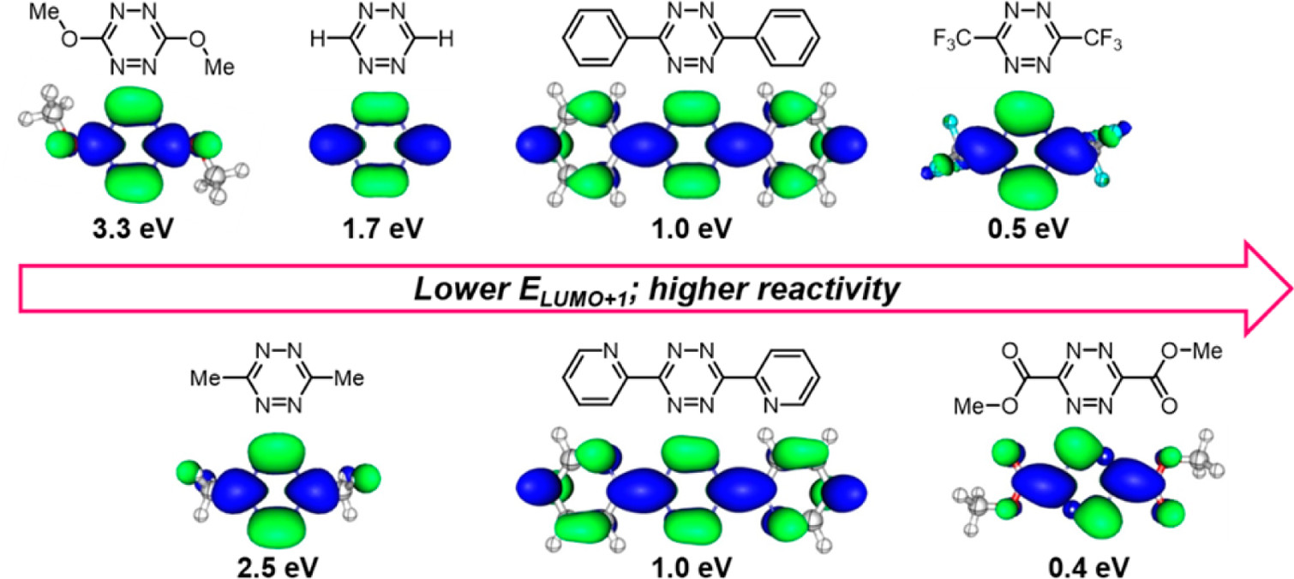
FMO Theory: Diels–Alder Reaction
rate limiting step
DOI:10.1021/ja505569a

Slide 41
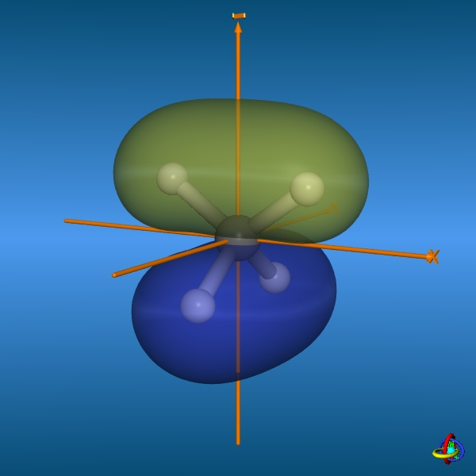
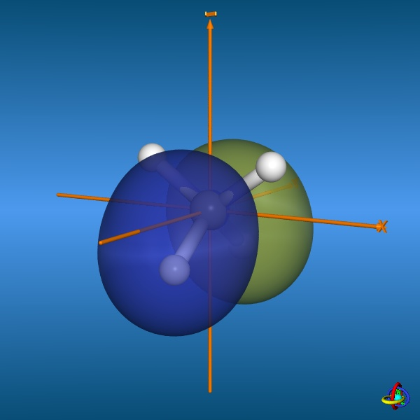
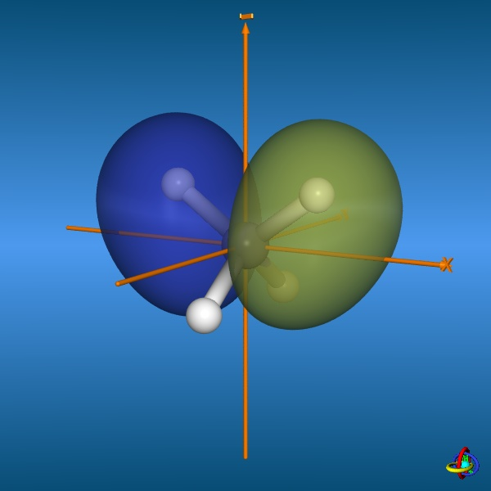
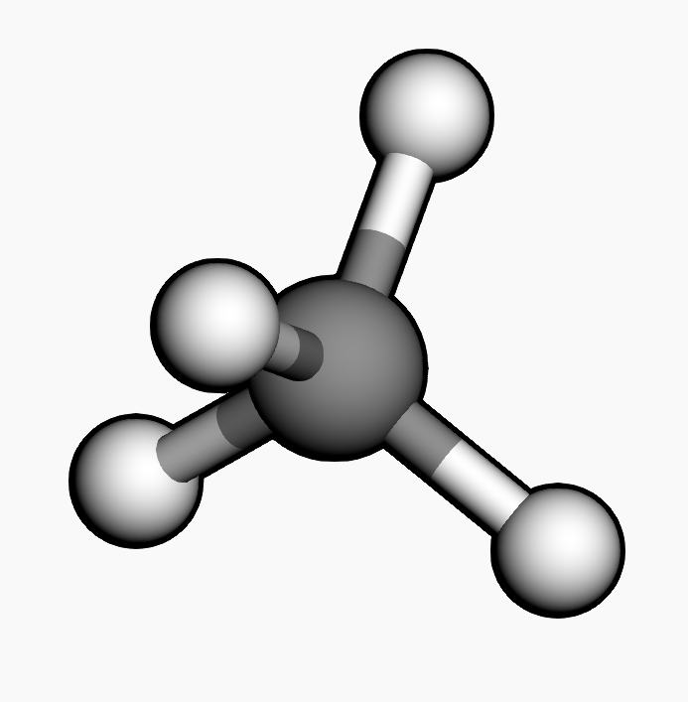
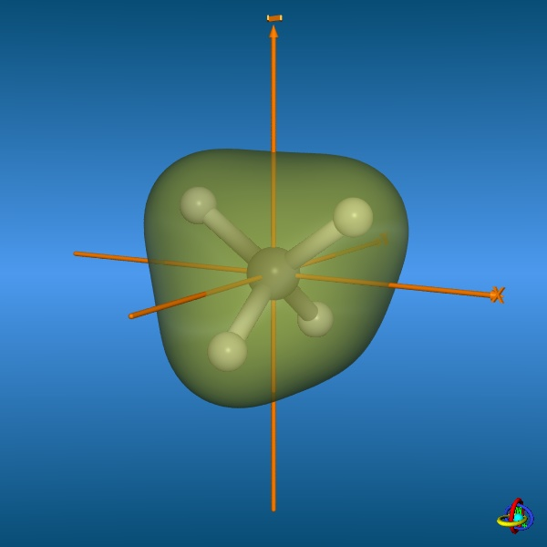
Canonical orbitals are delocalized
CH₄

Slide 42

Canonical orbitals are delocalized

Slide 43
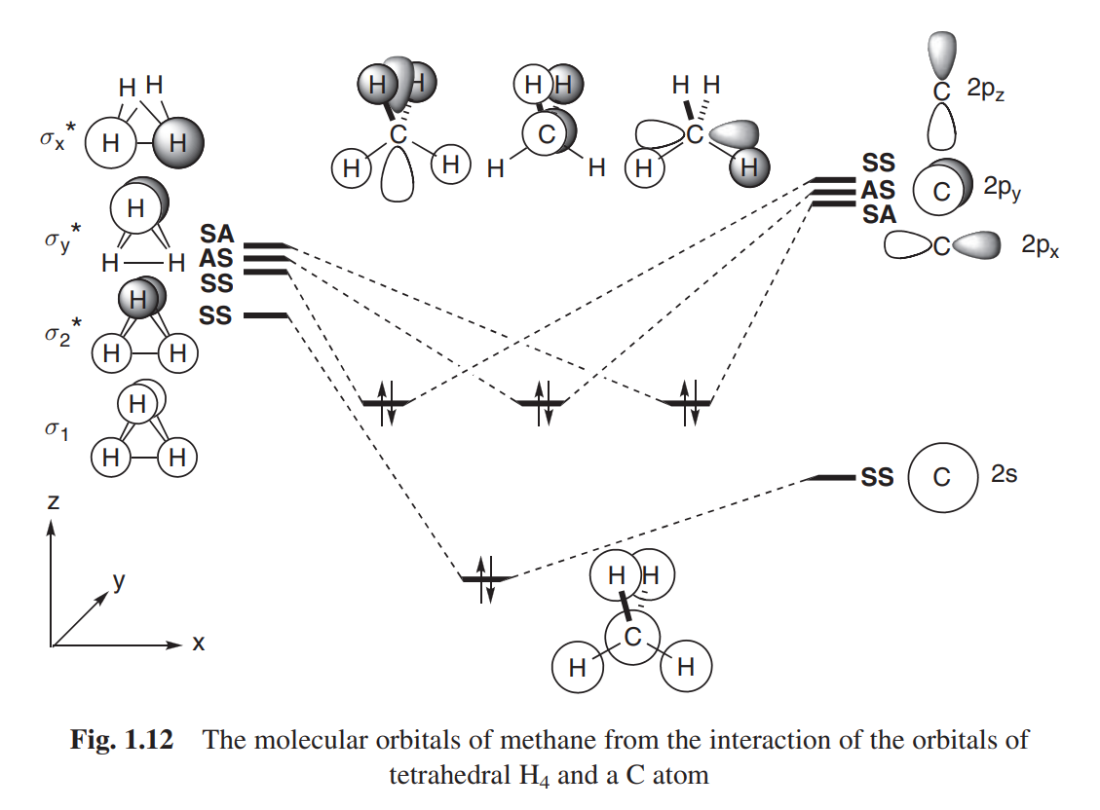
Canonical orbitals are delocalized

Slide 44
Canonical orbitals are delocalized
CH₄

Slide 45
Canonical orbitals are delocalized
σ-Orbital
CH₄

Slide 46
Localized Molecular Orbitals
We are allowed to make linear combinations of occupied orbitals
Such rotations do not change total energy or electron density
We can choose these combinations so that orbitals become spatially confined
These localized orbitals resemble bonds and lone pairs
Foster–Boys method (1950s): minimize orbital spatial spread

Slide 47
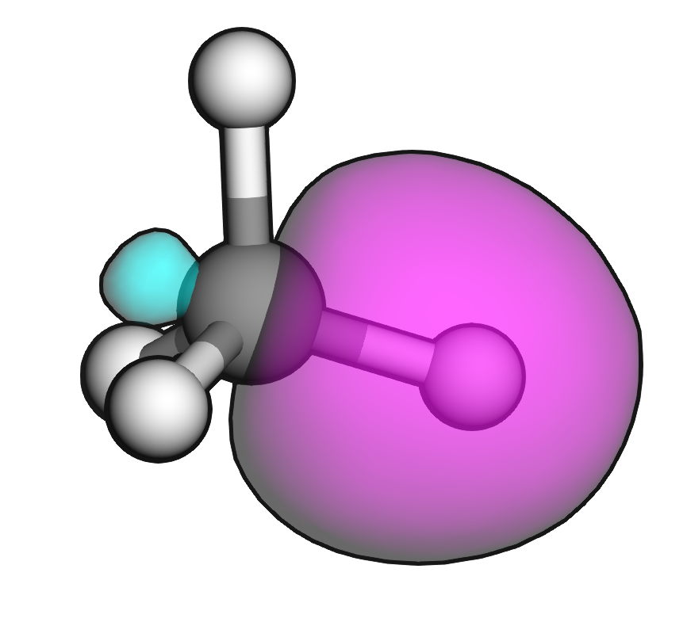
Localized Molecular Orbitals

Slide 48
Localized Molecular Orbitals
Pipek–Mezey (1989) – maximizes the localization of charge on individual atoms
Natural Bond Orbitals (NBOs) – fits orbitals to an idealized Lewis bonding pattern → interprets density in terms of classical bonds, lone pairs, and donor–acceptor interactions
Intrinsic Bond Orbitals (IBOs, Knizia 2013) – maximizes occupancy in intrinsic atomic orbitals → recovers clean σ and π bonds and lone pairs directly from the density

Slide 49
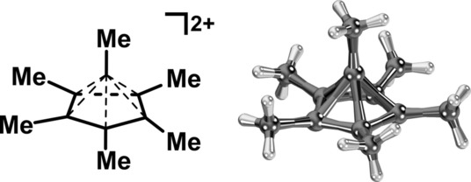
IBOs

Slide 50
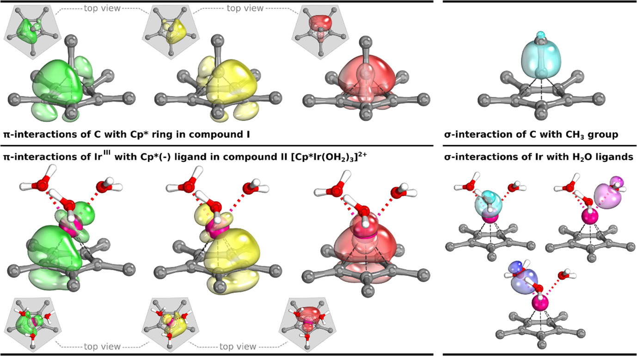
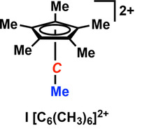
IBOs
DOI: 10.1002/chem.201705812

Slide 51


This teaching material is available at:
teaching.svatunek-lab.com
svatunek-lab.com
dennis.svatunek@tuwien.ac.at

